Slide 1



In the chat log, write one thing you wish you could change in the world.

Slide 2
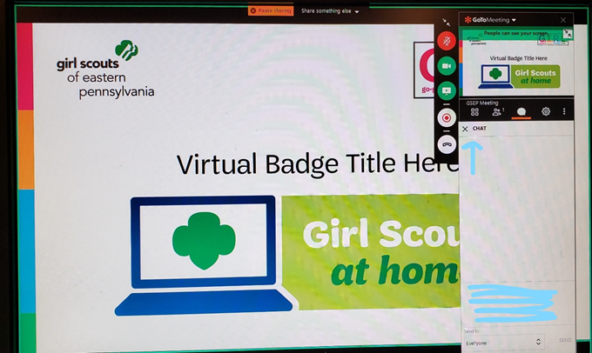
How will this Virtual Troop Meeting work?
•On the right side of your screen, there is a control panel. You should see a microphone, a video camera and a chat bubble.
•When we sing together, you will want to click on your microphone so it is green. Then everyone will be able to hear you.
•If you have a webcam, clicking on it will let everyone else in the meeting see you too.
• The Chat Log looks like a cartoon thought bubble…see it underlined in red? You can type questions or comments into the chat log and everyone will be able to see what you write!

Slide 3


Girl Scout Promise
and Law

Slide 4
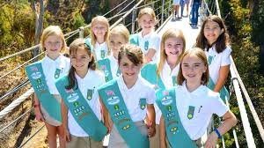
AGENT of Change
This week we will begin the process of getting to know one another. You’ll also get to know a little about “power” and how it can be used to create an “agent of change.”
You will begin to discover your own values and individual “powers.”

Slide 5

Welcome and Introductions
Notes:
NOTES:
Welcome each girl to Girl Scout VTM as she comes in.
Once all girls are in the Have each girl introduce themselves and tell what grade they are in and one Favorite thing they want to chare 5min

Slide 6

The Power of One
What does that mean?
Notes:
NOTES
Ask the girls what “power” means. Allow as many girls to answer as possible.
Tell the girls that we’re going to discuss a NEW definition of power, a power that they themselves have.

Slide 7
The Definition of POWER
pow·er
/ˈpou(ə)r/
noun
the ability to do something or act in a particular way, especially as a faculty or quality. "the power of speech"
.
the capacity or ability to direct or influence the behavior of others or the course of events. "she had me under her power"
Notes:
NOTES:
Ask the girls what power ISN’T about
Give the girls a few seconds to read the definition
Ask the group if they agree or disagree with the statement (write in CHAT LOG). If they disagree, ask them for reasons and explanations. (Remind them that it’s okay to have and share differing opinions)
Reinforce that expressing an opinion is a powerful act – and they’ve accomplished it. That’s another power that the girls can add to their list!

Slide 8

POWER Activity
Materials Needed
Paper (any kind)
Pencil or Pen
Write down a way or two that you’ve shown
your power.
Notes:
NOTES:
Ask if anyone wants to share a way that they’ve shown their power. (If they’re not ready to share yet, you start by giving a way you’ve shown your power – keep it simple).
Allow the girls to check out the POWERFUL awards and the Journey Power Award tracker, and then collect the books for the next meeting.
**Find pictures of these awards

Slide 9
The Meaning of “Me to the MAX”
It takes strength, skill, know-how, patience and hundreds of different qualities to do something YOU can be proud of. We are going to discover that everyone has a special blend of qualities that makes YOU special, unique.

Slide 10
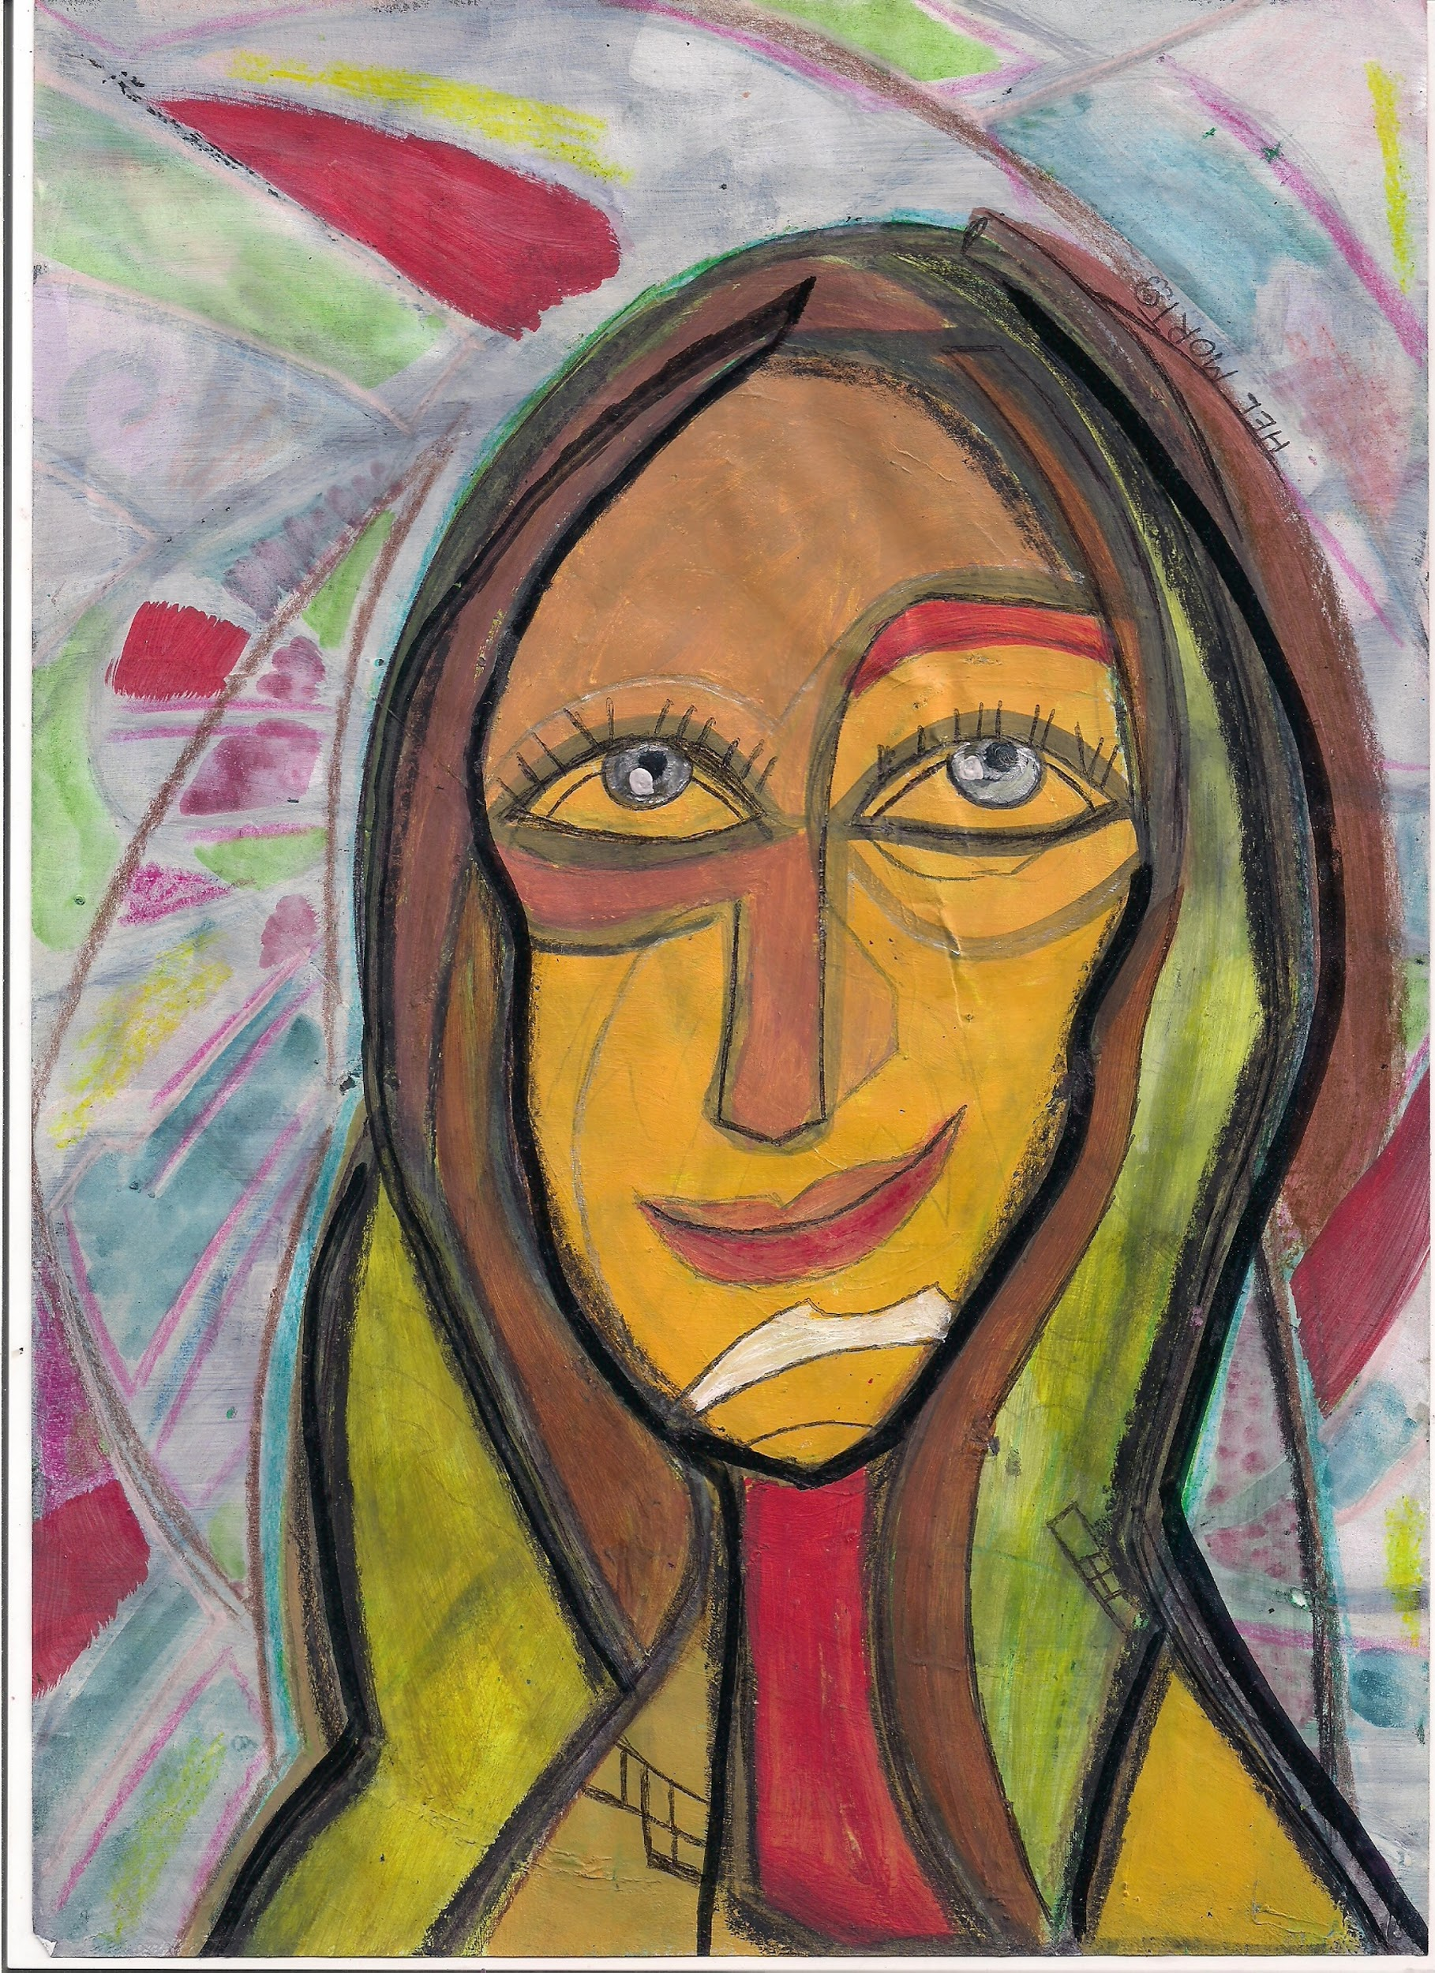
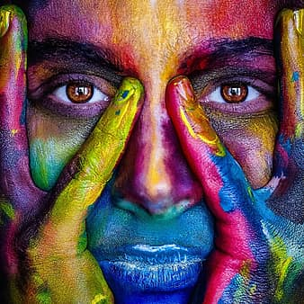
I’m Being Framed
Activity: Create a self-portrait collage by combining a picture of yourself with words you feels describes you.
SUPPLIES Needed
Paper or Construction paper
Picture of YOU
1-2 old magazines
Glue Stick or tape
Scissors
Marker
Notes:
NOTES:
Explain to the girls that brainstorming means that everyone has a chance to speak and there are no wrong answers
Ask the girls for words that describe the qualities of different people. GIVE SOME EXAMPLES
Have the girls write down the words that describe their own skills and strengths
If the word is already on the page, the girls can draw a line to it
If they want to the girls can add pictures of their loved ones, friends, interests.
If you are short on time the girls can write words instead of finding them in the magazines
If you don’t think they will finish have them complete it after the meeting. Everyone can show then during SESSION 2

Slide 11
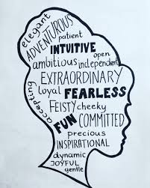
I’m Being Framed- QUALITIES
Notes:
NOTES:
Have the girls write down the words that describe their own skills and strengths
If the word is already on the page, the girls can draw a line to it
If they want, the girls can add pictures of their loved ones, friends, interests.
If you are short on time the girls can write words instead of finding them in the magazines
If you don’t think they will finish have them complete it after the meeting. Everyone can show then during SESSION 2

